Slide 1
Design & Applications of Optimal Decision Making Models
最佳化決策模式設計與應用
by
王 逸 琳 I-Lin Wang
ilinwang@mail.ncku.edu.tw
http://ilin.iim.ncku.edu.tw/
成功大學工業與資訊管理學系教授 2020/08/24-28 @成功校區 理學教學大樓(新大樓) 1樓36104室

Slide 2



In Class APP – Quiz, Exam, Homework
Moodle: http://moodle.ncku.edu.tw/
Install Moodle Mobile for NCKU (Android)
Install Moodle Classic (Android & iOS) connect to site: moodle.ncku.edu.tw
Online quiz & exam
Homework submission
ZUVIO 學生版課程代碼 51355919 http://zuv.io/51355919
Install zuvio APP (student) (Android & iOS)
Online in-class quiz

Slide 3
Course Plans
Day 1: 2020/08/24 Quiz 1 [8%] (moodle or Zuvio)
Introduction (OR, applications, model/algorithm, complexity), Project Intro.
Software Installation & Demo (by TAs)
Day 2: 2020/08/25 Quiz 2 [8%], Project 1 due 08/29 11pm [15%]
Basics of Linear Programming & Integer Programming; LP modeling
Day 3: 2020/08/26 Quiz 3 [8%], Project 2 due 08/30 11pm [15%]
IP modeling techniques
Day 4: 2020/08/27 Quiz 4 [8%]
Applications: Facility Locations, Logistics Management, Routings (TSP)
Project Implementation help (by TAs)
Day 5: 2020/08/28 Quiz 5 [8%]
Applications: Routings (RPP), Scheduling (RCPSP)
Project Implementation help (by TAs)
Day 6: 2020/08/29 1-hr on-line Exam (moodle) [20%]

Slide 4







Background of the Lecturer
Undergraduate (87~91) : Aerospace engineering, NCKU
Orbital mechanics
Master (94~96) : Operations Research Center, MIT
Premultiplier network simplex algorithm under Prof. Orlin
Researcher (96~97) : Network system lab, Fujitsu, JP
Optical network wavelength routing & assignment algorithm
Ph.D. (98~03) : ISyE, GA Tech
Shortest paths and multicommodity flows under Prof. Johnson
The Logistics Institute at Asia Pacific
Assistant professor (03~07) : IIM, NCKU
Network optimization, Reverse logistics, Bioinformatics
Associate professor (07~14) : IIM, NCKU
Network optimization with applications in Transportation

Slide 5
Research Interests [Optimization, OR]
Network Optimization
Logistics, Supply Chain Management
Shared Mobility
Unmanned Vehicle Operations (UAV/USV/Autonomous Car)
Resource Constrained Project Scheduling
Patrol Routing in MRT/Train/Rail Systems
Railway Optimization (INFORMS RAS PSC 6 awards)
Semiconductor Manufacturing
Pavement Optimization
Bioinformatics
Personal Navigation
Telecommunication, Network Reliability, Data Mining

Slide 6
decision making
Operations Research
examples
Mathematical Programming
Linear Program
Integer Program

Slide 7
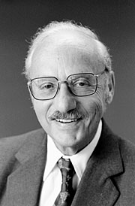
Operations Research (OR)
Operations Research is an Art and Science
It had its early roots in World War II and is flourishing in business and industry with the aid of computer
Primary applications areas of OR include forecasting, production scheduling, inventory control, capital budgeting, and transportation
OR began in a systematic way after late 1930’s
George B. Dantzig (Wikipedia, Mathematics Genealogy)
More about Dantzig (interview 86, ref05, ref06, ref08)

Slide 8
Brief History of OR
1890
Frederick Taylor
Scientific Management
[Industrial Engineering]
1900
Henry Gannt
[Project Scheduling]
Andrey A. Markov
[Markov Processes]
Assignment
[Networks]
1910
F. W. Harris
[Inventory Theory]
E. K. Erlang
[Queuing Theory]
1920
William Shewart
[Control Charts]
H.Dodge – H.Roming
[Quality Theory]
1960
John D.C. Litle
[Queuing Theory]
Simscript - GPSS
[Simulation]
1950
H.Kuhn - A.Tucker
[Non-Linear Prog.]
Ralph Gomory
[Integer Prog.]
PERT/CPM
Richard Bellman
[Dynamic Prog.]
ORSA and TIMS
1940
World War 2
George Dantzig
[Linear Programming]
First Computer
1930
Jon Von Neuman – Oscar Morgenstern
[Game Theory]
1970
Microcomputer
1980
H. Karmarkar
[Linear Prog.]
Personal computer
OR/MS Softwares
1990
Spreadsheet Packages
INFORMS
2020
You are here

Slide 9
What is Operations Research?
Operations
The activities carried out in an organization.
Research
The process of observation and testing characterized by the scientific method.
Situation, problem statement, model construction, validation, experimentation, candidate solutions.
Operations Research
a quantitative approach to decision making based on the scientific method of problem solving.

Slide 10
Scientific Approaches in OR
The art of mathematical modeling of complex situations
The science of the development of solution techniques used to solve these models
The ability to effectively communicate the results to the decision maker
OR professionals provides rational bases for decision making by seeking to understand and structure complex situations, then to predict system behavior and improve system performance.
Using analytical and numerical techniques to develop mathematical and computer models of organizational systems composed of people, machines, and procedures
➔ Science of Better!!

Slide 11
Terminology
The British/Europeans refer to “Operational Research", the Americans to “Operations Research" - but both are often shortened to just "OR".
Another term used for this field is “Management Science" ("MS"). In U.S. OR and MS are combined together to form "OR/MS" or "ORMS".
Yet other terms sometimes used are “Industrial Engineering" ("IE") and “Decision Science" ("DS").

Slide 12
OR Models
Deterministic Models
• Linear Programming
• Network Optimization
• Integer Programming
• Nonlinear Programming
Stochastic Models
• Discrete-Time Markov Chains
• Continuous-Time Markov Chains
• Queuing Theory (waiting lines)
• Decision Analysis
• Inventory Models
• Game Theory
• Inventory models
• Simulation

Slide 13
Overview of Optimization
Categories of optimization problems 14-15
Deterministic vs. stochastic
Linear vs. nonlinear
Continuous vs. Discrete
Fractional vs. integral
Difficulty of optimization problems & solution methods 16-17
Polynomial time, Exponential time, NP
Solution methods & software packages 18-19
Optimal solution vs. good solution (exact vs. approximate)

Slide 14
Categories of optimization problems (1/2)
Mathematical programming problem
Decision variables, Objective function, constraints
Deterministic vs. stochastic
LP, NLP, IP, DP ➔ deterministic
Probability, expectation ➔ stochastic
Solving stochastic opt by deterministic opt soln methods
Linear vs. nonlinear
Objective function, constraints
KKT conditions (1st 2nd derivatives=0)
Global optimum vs. local optimum
Simplex method vs. newton’s method

Slide 15
Categories of optimization problems (2/2)
Continuous vs. Discrete
Continuous opt is usually easier (e.g., LP vs. IP)
Continuous opt : by Gradient oriented methods (e.g., NLP)
Discrete opt : by enumeration (e.g., IP)
Fractional vs. integral
Fractional opt is usually easier
Special case : network structure (Total unimodularity, TUM)
Single objective vs. multiple objectives
Weighted sum of different objectives
Convexity in objective function (e.g., linear, quadratic)
Convexity in variable domain (i.e., convex set)

Slide 16
Difficulty of problems & methods (1/2)
Difficulty ⬅➔ complexity
# basic operations executed by an algorithm
In terms of the problem input size (e.g., # var., constraints)
Worst case analysis, big-O notation
Poly-time solvable ➔ easy problem, efficient algorithm
Difficulty for a problem is measured by its most efficient algorithm
Problem difficulty ≠ difficulty of solution methods
Easy problem may be solved by stupid method (e.g., shortest path problem)
Problem difficulty is independent of its formulations
Neat / short formulation may be more difficult to solve

Slide 17
Difficulty of problems & methods (2/2)
Nondeterministic Polynomial (NP) class
Used to classify the difficulty for problems, not for algorithms
No poly-time algorithm found, but no proofs
LP : in P class
Poly-time method : Interior point method, theoretically good
Simplex method : case dependent, practically efficient
NLP :
Case dependent (usually no one cares)
IP : case dependent, usually in NP class
Branch & bound, branch & cut
Network problem : specialized LP/IP, thus in P class
Shortest path, maximum flow, minimum cost, assignment,…

Slide 18
Opt solutions vs. Good solutions
Opt = exact opt (of course Global opt)
Time consuming
Good solution
With bounds : by approximation algorithms
Without bounds : heuristics (meta-heuristics, matheuristic)
Computational evaluation :
Effectiveness:
Optimality gap (100% * |z-z*|/z*)
Efficiency:
Running time (Worst case, avg case)

Slide 19
Software packages
LP
ILOG CPLEX ; GuRoBi
Interactive mode
Callable library
Dash XPRESS-MP
ILOG AMPL
LINDO, LINGO
QSopt
NLP
LINGO (reliable??)
IP
ILOG CPLEX ; GuRoBi
Dash XPRESS-MP
NEOS Server (http://www.neos-server.org/neos/)

Slide 20
Optimization models…
Optimization aims at finding the best configuration of processes, systems, products, etc.
It relies on a theory developed mostly in the past 90 years
Applying Optimization in an industrial, financial, logistic context yields a better use of budget / resources ($$$) or a higher revenue ($$$)

Slide 21
…and applications
Source: http://www.informs.com
(see also http://www.scienceofbetter.org)
yr | Company | Result
86 | Eletrobras (hydroelectric energy) | 43M$ saved
90 | Taco Bell (human resources) | 7.6M$ saved
92 | Harris semicond. prod. planning | 50%→95% orders “on time”
95 | GM－ Car Rental | +50M$
96 | HP printers－re-designed prod. | 2x production
99 | IBM－ supply chain | 750M$ saved
00 | Syngenta－ corn prodction | 5M$ saved

Slide 22
An example
you work at a company that sells food in glass containers only. Today your boss has a bright idea! The tin can®.It’s a cylinder made of tin.
The can must contain V = 20 cu. In. (11 fl.oz., 33cl)
Cut and solder tin foil to produce cans
Tin (foil) is expensive, use as little as possible
Boss: “What is the ideal can? Tall and thin or short and fat?”
You: A cylinder with volume V using as little tin as possible

Slide 23
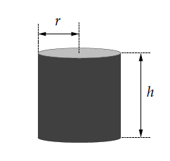
Example

Slide 24
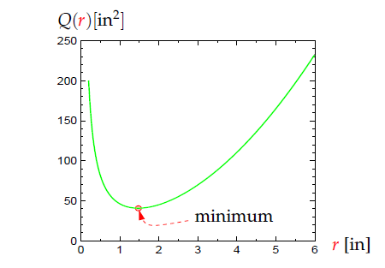
Minimize the quantity of tin
Notes:
Proof of Thm 4.4: if U=V, just select that vertex; if all vertices are different, done; o.w. at least 2 vertices on the path are the same, deleting those edges in between will still keep a path connecting U,V. keep doing these deletion until there is no repeated vertices; since the # of vertices are finite, this process will give a simple U-V path
Chinese postman problem:
Find a minimum length closed walk that traverses each edge AT LEAST ONCE
Fining an optimal solution is NP-complete

Slide 25
Aims of this course
Model optimization problems
So that they can be solved
Learn an optimization software (e.g., GuRoBi)
Apply GuRoBi to solve real-world problems
Notes:
Pf:
(a)<= : when the circuit passes a vertex, there is an entering edge, and a leaving edge (different from the entering edge), since each edge is passed exactly once, thus there are 2|V| edges which is an even # => choose a starting vertex u, if there is a loop on u, pass it, then leave u along an edge (u,u1) (it must exist since there are more than 2 vertices and the graph is connected), in u1, if there is a loop on u1, pass it, then leave u1 along an edge other than any edge that has been passed like (u1,u) (it must exist since each vertex has even degree) to vertex u2. Repeat these steps until finally we return u. (this has to happen since # edge is finite and the graph is connected) Then we get a circuit C1 from u to u.
If C1 covers all the edge, then we get an Euler circuit, done.
Otherwise, we delete all the edges on C1 from G, then delete all the isolated vertices from G, and obtain the remaining subgraph G1.
On G1, we choose a vertex v (it exists due to connected graph), and do the same steps as above to form a circuit C2 back to v.
Now, combine C1 & C2, we get a larger circuit C’ starts from u along C1 to v, then along C2 back to v, and along C1 back to u. if C’ covers all the edges, we are done. Otherwise, we repeat the same procedures until finally all the edges are covered. The algorithm will stop since the graph is finite, at which time, we obtain an Euler circuit by combining all the smaller circuits.
(b,c)<= trivial
=> Add an artificial edge between the 2 vertices with odd degrees, we can form an Euler circuit, then we remove the artificial edge and obtain the Euler path

Slide 26
Your first optimization model
Variables | r: radius of the can’s base h:height of the can
Objective
Constraints

Slide 27
Optimization Models, in general, have:
Variables: height and radius, number of trucks,… The unknown (and desired) part of the problem (one thing your boss cares about)
Constraints: physical, explicit (V=20 ), imposed by law, budget limits… They define all and only values of the variables that give possible solutions.
Objective function: what the boss really cares about.
Quantity of tin, total cost of trucks, total estimated revenue,…a function of the variables

Slide 28
The general optimization problem
Consider a vector x in of variables
An optimization problem can be expressed as
P: minimize
s.t.

Slide 29
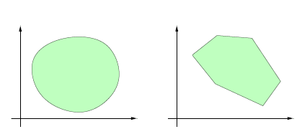
Convex sets
Def:
The intersection of two convex sets is convex.
Notes:
Sir William Rowan Hamilton, developed a puzzle (a dodecahedron[12facets], 20 vertices[cities]) whose answer required the construction of Hamiltonian cycle
Show Ore’s Thm: by contradiction, Suppose such G has NO Ham.cyc.
G is a subgraph of Kn (but not Kn).
We can recursively add edges between 2 nonadj vert of G until it becomes a H where adding one more edge joining 2 nonadj vert in H will create a Ham.cyc.
Let x,y be 2 nonadj vert in H ➔ x,y are nonadj in G
Known: deg(x)+deg(y)≧n in G ➔ deg(x)+deg(y)≧n in H
If we add a new edge (x,y) on H ➔ create a Ham.cyc. (by assumption)
i.e. there exists a Ham.path from x to y, say, x=v1-v2-v3-…-vi-1-vi-vi+1-…-vn-1-vn=y
Suppose deg(x)=r
Claim: if there exists an edge (x,vi), then there exists NO edge (vi-1,y)
Pf: o.w. H has a Ham.cyc. -><-
The claim is tru for I=2,3,…,n-1
Since deg(x)=r, there exists r vertices in {v1,v2,…,vn-1} NOT adj to y
Thus deg(y)<=(n-2)-r which means deg(x)+deg(y)<=n-2<n -><-

Slide 30
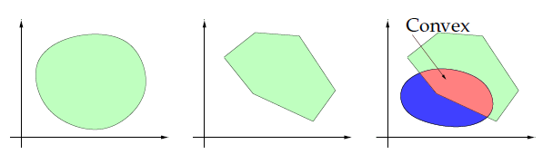
Examples: Convex sets
Notes:
Show Dirac’s Thm: deg(v)>=n/2, so deg(u)+deg(v)>=n for any vertices u,v
of course it’s also true for any nonadj vertices u,v, thus by Ore’s thm, done
Ex1: (a) 1-2-3-4-1 (b) 1-2-3-4-5-3-1 (c) 1-2-3-4-1; (1,3)

Slide 31
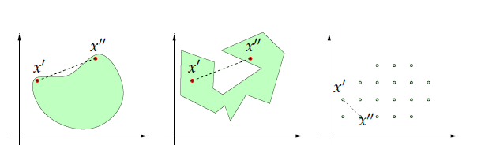
Examples: Nonconvex sets

Slide 32
Convex function
Def:
The sum of convex functions are still convex
Multiply a convex function by a positive scalar will give a convex function
Linear functions are always convex

Slide 33
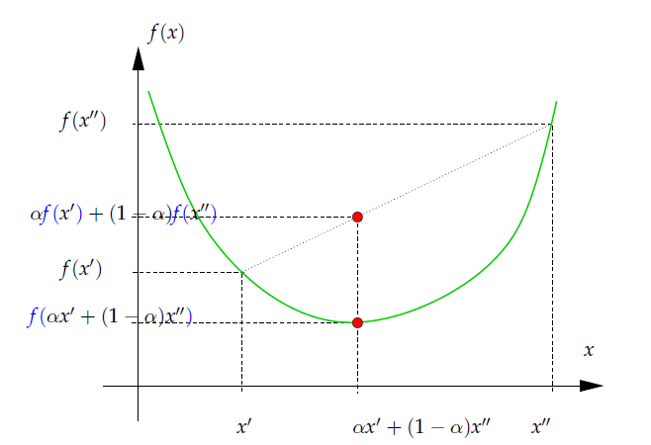
Definition

Slide 34
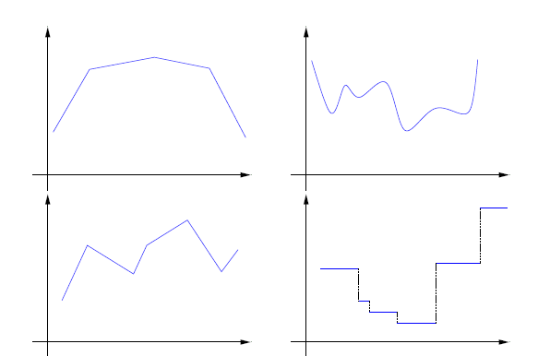
Definition
ALL these functions are nonconvex

Slide 35
Examples
►
►
►
►
►
►
►
►
►
►
CalcPlot3D

Slide 36
Convex Constraints
►
►
►
►

Slide 37
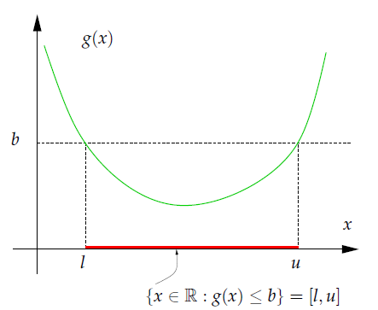
Convex Constraints
if the function is convex, the constraint may be nonconvex!!
: convex function
: convex set

Slide 38
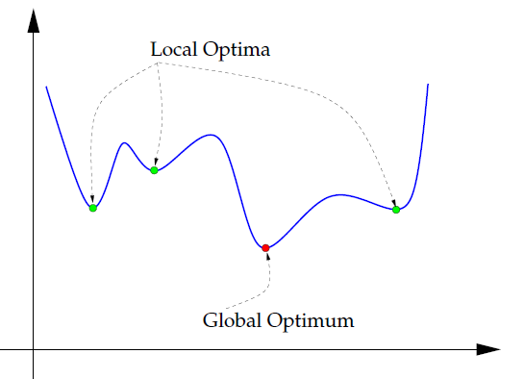
Local optima, global optima

Slide 39
Convex problems
Def.: An optimization problem is convex if
► the objective function is convex
► all constraints are convex
Convex optimization problems are easy :
➔ any local optimum is also a global optimum.
➔ When modeling an optimization problem, it would be good if we found a convex problem.

Slide 40

Relaxation of an Optimization problem
Consider again a problem
► deleting a constraint from P provides a relaxation of P
► adding a constraint $f_{m+1}(x)≤b_{m+1}$
provides a restriction of P ,i.e., the opposite:

Slide 41
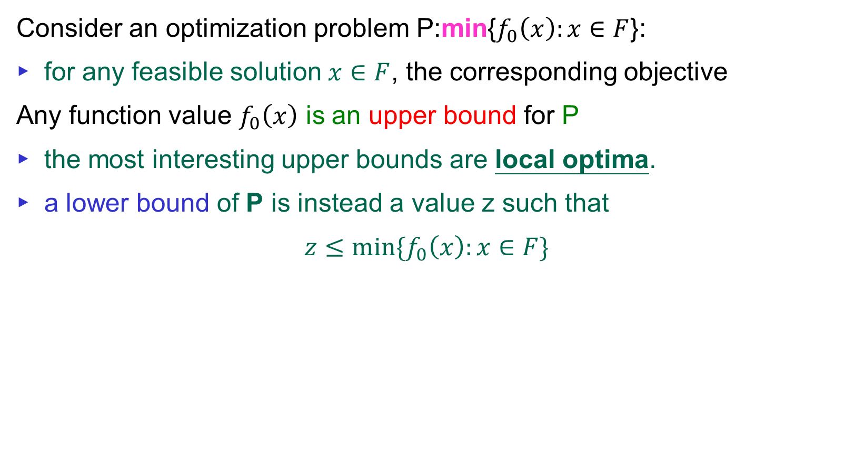
Lower and upper bounds
Consider an optimization problem P:min{$f_{0}\left(x\right):x∈F$}:
► for any feasible solution $x∈F$, the corresponding objective
Any function value $f_{0}\left(x\right)$ is an upper bound for P
► the most interesting upper bounds are local optima.
► a lower bound of P is instead a value z such that
$$z≤min⁡\{f_{0}\left(x\right):x∈F\}$$

Slide 42
Upper vs. Lower bounds
Situation #1:
You: “We found a solution that will only cost 372,000$.”
Boss: ”Ok, that sounds good.”
Situation #2:
You: “We found a solution that will only cost 372,000$.”
Boss: ”That’s too much, find something better.”
…..
You: “We found a solution that will only cost 354,000$.”
Boss: ”Can’t you do better than that?”
You: “I can try again, but here’s the proof that
we can’t go below 351,500$.”
Boss: ”Ok then, that’s a good solution.”
➔ Upper bd: 372,000
Lower bd: 351,500

Slide 43
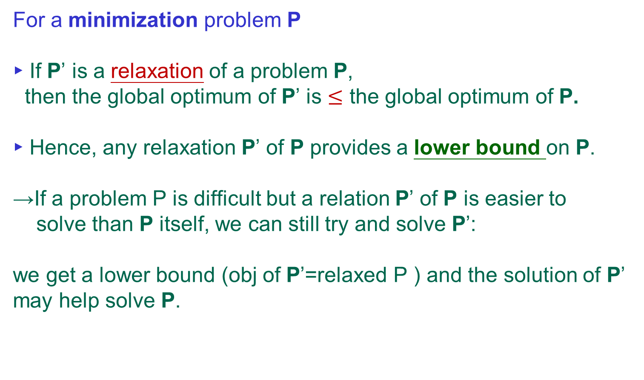
What relaxations are for
For a minimization problem P
► If P’ is a relaxation of a problem P, then the global optimum of P’ is $≤$ the global optimum of P.
► Hence, any relaxation P’ of P provides a lower bound on P.
→If a problem P is difficult but a relation P’ of P is easier to
solve than P itself, we can still try and solve P’:
we get a lower bound (obj of P’=relaxed P ) and the solution of P’ may help solve P.
Notes:
Proof of Thm 4.4: if U=V, just select that vertex; if all vertices are different, done; o.w. at least 2 vertices on the path are the same, deleting those edges in between will still keep a path connecting U,V. keep doing these deletion until there is no repeated vertices; since the # of vertices are finite, this process will give a simple U-V path
Chinese postman problem:
Find a minimum length closed walk that traverses each edge AT LEAST ONCE
Fining an optimal solution is NP-complete

Slide 44
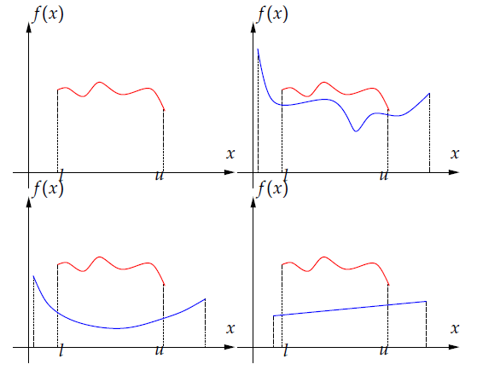
Relaxation of an Optimization problem
Notes:
Pf:
(a)<= : when the circuit passes a vertex, there is an entering edge, and a leaving edge (different from the entering edge), since each edge is passed exactly once, thus there are 2|V| edges which is an even # => choose a starting vertex u, if there is a loop on u, pass it, then leave u along an edge (u,u1) (it must exist since there are more than 2 vertices and the graph is connected), in u1, if there is a loop on u1, pass it, then leave u1 along an edge other than any edge that has been passed like (u1,u) (it must exist since each vertex has even degree) to vertex u2. Repeat these steps until finally we return u. (this has to happen since # edge is finite and the graph is connected) Then we get a circuit C1 from u to u.
If C1 covers all the edge, then we get an Euler circuit, done.
Otherwise, we delete all the edges on C1 from G, then delete all the isolated vertices from G, and obtain the remaining subgraph G1.
On G1, we choose a vertex v (it exists due to connected graph), and do the same steps as above to form a circuit C2 back to v.
Now, combine C1 & C2, we get a larger circuit C’ starts from u along C1 to v, then along C2 back to v, and along C1 back to u. if C’ covers all the edges, we are done. Otherwise, we repeat the same procedures until finally all the edges are covered. The algorithm will stop since the graph is finite, at which time, we obtain an Euler circuit by combining all the smaller circuits.
(b,c)<= trivial
=> Add an artificial edge between the 2 vertices with odd degrees, we can form an Euler circuit, then we remove the artificial edge and obtain the Euler path

Slide 45
The knapsack problem
At a flea market in Rome, you spot n objects (old pictures, a vessel,
Rusty medals…) that you could re-sell in your antique shop for about
double the price.
►You want these objects to pay for your flight ticket to
Rome, which cost C.
►Also, your backpack CAN carry all of them, but you don’t want it
heavy, so you want to buy the objects that will load your backpack
as little as possible.
How do you solve this problem?

Slide 46
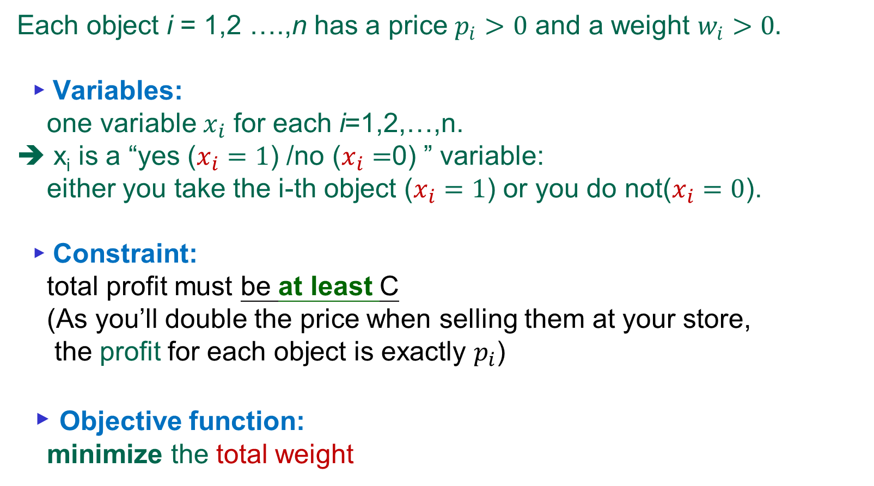
The knapsack problem
Each object i = 1,2 ….,n has a price $p_{i}>0$ and a weight $w_{i}>0.$
► Variables:
one variable $x_{i}$ for each i=1,2,…,n.
➔ x_{i} is a “yes ($x_{i}=1$) /no ($x_{i}=$0) ” variable: either you take the i-th object ($x_{i}=1$) or you do not($x_{i}=0$).
► Constraint:
total profit must be at least C
(As you’ll double the price when selling them at your store,
the profit for each object is exactly $p_{i}$)
► Objective function:
minimize the total weight

Slide 47
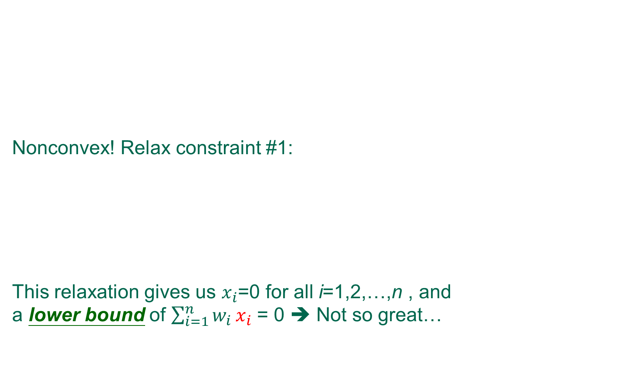
First optimization model & Relax#1
Nonconvex! Relax constraint #1:
This relaxation gives us $x_{i}$=0 for all i=1,2,…,n , and a lower bound of $\sum_{i=1}^{n}{w_{i}}x_{i}$ = 0 ➔ Not so great…

Slide 48
Relax#2 : Linear Relaxation
Relaxation#2: (linear relaxation, i.e., relax the integral constraint)
By relaxing integrality we admit fractions of objects.
It is as if we pulverized object and took some spoonful of each.
This relaxation gives a better lower bound.(than 0 by R#1)
Notes:
Sir William Rowan Hamilton, developed a puzzle (a dodecahedron[12facets], 20 vertices[cities]) whose answer required the construction of Hamiltonian cycle
Show Ore’s Thm: by contradiction, Suppose such G has NO Ham.cyc.
G is a subgraph of Kn (but not Kn).
We can recursively add edges between 2 nonadj vert of G until it becomes a H where adding one more edge joining 2 nonadj vert in H will create a Ham.cyc.
Let x,y be 2 nonadj vert in H ➔ x,y are nonadj in G
Known: deg(x)+deg(y)≧n in G ➔ deg(x)+deg(y)≧n in H
If we add a new edge (x,y) on H ➔ create a Ham.cyc. (by assumption)
i.e. there exists a Ham.path from x to y, say, x=v1-v2-v3-…-vi-1-vi-vi+1-…-vn-1-vn=y
Suppose deg(x)=r
Claim: if there exists an edge (x,vi), then there exists NO edge (vi-1,y)
Pf: o.w. H has a Ham.cyc. -><-
The claim is tru for I=2,3,…,n-1
Since deg(x)=r, there exists r vertices in {v1,v2,…,vn-1} NOT adj to y
Thus deg(y)<=(n-2)-r which means deg(x)+deg(y)<=n-2<n -><-

Slide 49

Examples
Suppose there are n = 9 objects and C = 70
A local optimum is 8, solution is (1,0,1,0,0,0,1,0,0).
R#1: lower bound is 0, solution is (0,0,0,0,0,0,0,0,0).
R#2: lower bound is 5.71, solution is (0,1,0,0,0,0.903,1,0).
Global optimum is 6, solution is (0,1,0,0,0,0,1,1,0).
Notes:
Show Dirac’s Thm: deg(v)>=n/2, so deg(u)+deg(v)>=n for any vertices u,v
of course it’s also true for any nonadj vertices u,v, thus by Ore’s thm, done
Ex1: (a) 1-2-3-4-1 (b) 1-2-3-4-5-3-1 (c) 1-2-3-4-1; (1,3)

Slide 50
To recap
► convex problems are good (easier to solve)
► for a nonconvex model, look for a (possibly convex) relaxation
► use it to get a lower bound (for minimization problem)

Slide 51
Q & A
Thanks!
I-Lin Wang (王逸琳)
Professor
Dept of Industrial & Information Management
National Cheng Kung University http://ilin.iim.ncku.edu.tw/

